Slide 1
Data Base and Visualization Part
InfluxDB: InfluxDB is a specialized database designed to handle data that changes over time, such as temperature, humidity and any other parameters measurements from sensors. It can quickly store and manage lots of data that comes in continuously.
Grafana: Grafana is a tool that lets you make and share interactive charts and graphs using data from various sources like InfluxDB. It helps you visualize data in a way that's easy to understand, allowing you to see trends and patterns.

Slide 2
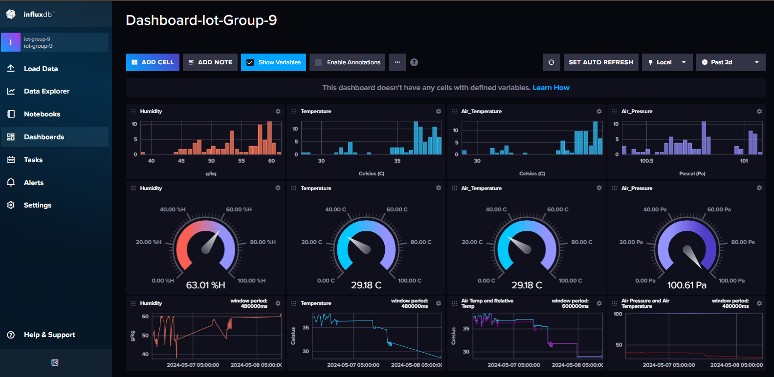
Data Collection and Storage with InfluxDB:
Receive Data: Our system involves multiple sensors connected to ESP32 devices that publish data to an MQTT broker. The broker, in turn, channels this data to the command center.
InfluxDB as Data Sink: From the command center, data is pushed to InfluxDB. My primary role is to ensure that InfluxDB correctly receives and stores these data points. This includes configuring InfluxDB to handle the incoming data flow efficiently, setting up databases, retention policies, and continuous queries to manage the data effectively.

Slide 3
Data Visualization with Grafana:
Dashboard Setup: I was responsible for setting up Grafana dashboards that connect to the InfluxDB data source. These dashboards are crucial for visualizing the IoT data collected.
Customizing Visuals: Designing and customizing the Grafana dashboards to display data in an interpretable and meaningful way. This includes selecting the right types of graphs and charts (like line charts, gauges, bar charts) that best represent the time-series data from our sensors.
Real-time Monitoring: Ensuring that the dashboards update in real-time to reflect the most current data from the devices. This involves setting up refresh rates and queries that pull the latest data from InfluxDB.

Slide 4
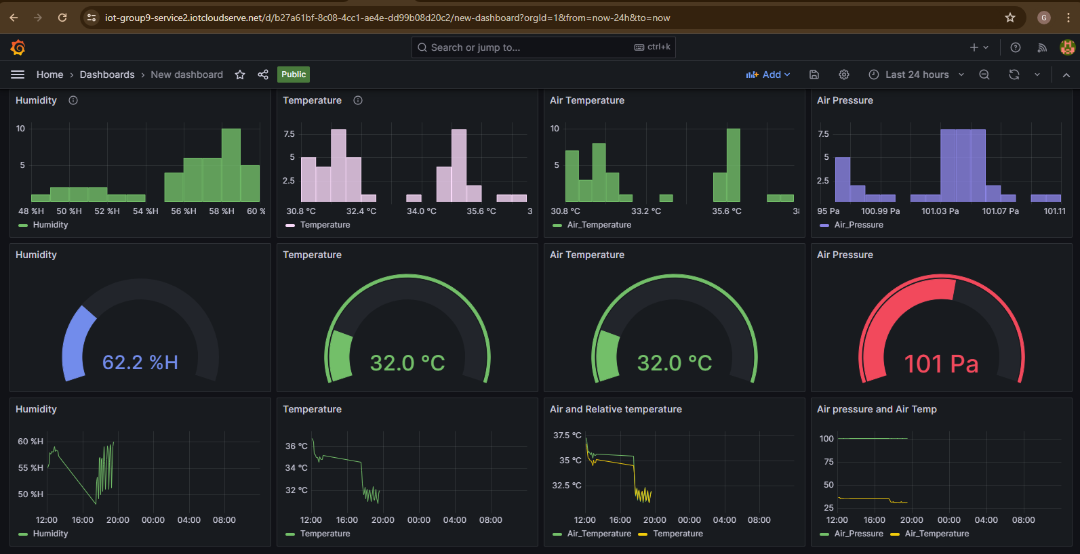
Data Visualization with Grafana:

Slide 5
Management and Maintenance:
Data Integrity and Availability: Regular checks to ensure data is accurately recorded and readily available for queries and visualization.
Performance Optimization: Tuning the performance of both InfluxDB and Grafana to handle potentially large volumes of data without lag, ensuring smooth operation of the dashboards.
Security and Access Controls: Implementing security measures to protect the data and control access to the dashboards, especially if they are to be accessible over the internet.
Interfacing and Collaboration:
Integration: Ensuring that the database and visualization components integrate seamlessly with other parts of the IoT architecture, like the MQTT broker and command center.
Collaboration: Working with other team members responsible for the hardware, MQTT broker, and data analytics to ensure all components work together effectively.

Slide 6
My role as responsible for both the database and visualization segments is critical in providing a backbone for data management and analysis in our IoT project. So I needed to ensure that the data not only is stored efficiently and securely in InfluxDB but also is effectively presented through Grafana dashboards to facilitate easy interpretation and timely decision-making by our team.
Link for public to access the data on our dashboard
https://iot-group9-service1.iotcloudserve.net/public-dashboards/f04ab8d463984deda1a90e9c6214295c

